Slide 1


Swedish Taxation Since 1862
Mikael Stenkula
November 2014

Slide 2
Background
IFN Project:
Describe and analyze the Swedish tax system from a long-term perspective (1862−today)
Why?
Taxes have profound effects on economic behavior
Detailed knowledge on the structure and evolution of taxation is needed

Slide 3
Background
IFN Project:
Describe and analyze the Swedish tax system from a long-term perspective (1862−today)
Why 1862?
6 key aspects:
Labor income taxation (Gunnar Du Rietz, Dan Johansson, Mikael Stenkula)
Capital income taxation (Gunnar Du Rietz, Dan Johansson, Mikael Stenkula)
Wealth taxation (Gunnar Du Rietz, Magnus Henrekson)
Inheritance and gift taxation (Gunnar Du Rietz, Magnus Henrekson, Daniel Waldenström)
Taxation of goods and services (Mikael Stenkula)
Taxation of real estate (Mikael Stenkula)

Slide 4
Background
IFN Project:
Describe and analyze the Swedish tax system from a long-term perspective (1862−today)
…so far:
8 working papers
4 paper accepted in peer-reviewed journals
1 paper under review
1 book with 7 chapters (Palgrave Macmillan)

Slide 5
Background
Earlier historical studies:
Swedish
Genberg (1942), Rodriguez (1980, 1981), Gårestad (1987), Söderberg (1996), Lodin (2011).
International
Weber and Wildavsky (1986), Steinmo (1993), Scheve and Stasavage (2012) and Piketty (2014)

Slide 6
Tax-to-GDP ratio, 1862−2013 (%)

Slide 7
Tax-to-GDP ratio, 1862−2013 (%)

Slide 8
The composition of total tax revenue, 1862–2013 (%)

Slide 9
Labor income taxation
Major state income tax reforms:
1862 New appropriation tax (bevillning)
1903 Progressive income tax – income tax return
1920, 1939, 1948 temporary tax increases made permanent
1971 Increased progressivity, individual/separate taxation
1983−1985 Tax reform of the “wonderful night” (underbara natten)
1990−1991 ”Tax reform of the century” (århundradests skattereform)
Dual tax system

Slide 10
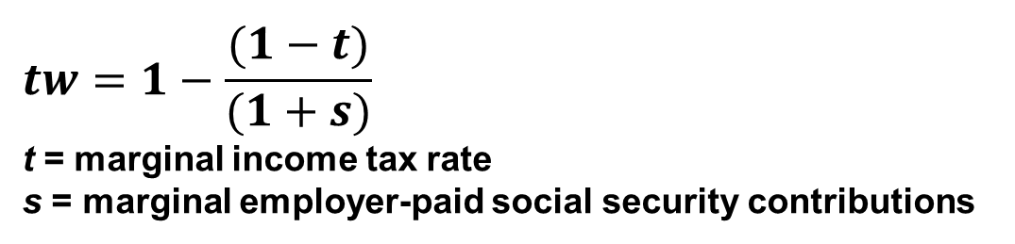
Marginal tax wedge
$$tw=1−\frac{(1−t)}{(1+s)}$$
t = marginal income tax rate
s = marginal employer-paid social security contributions
Income levels:
100% of an annual average prodution worker wage (APW)
67% of an annual average prodution worker wage (APW)
167% of an annual average prodution worker wage (APW)
Top marginal tax wedge

Slide 11
Marginal tax wedge (%)

Slide 12
Marginal tax rate (%)

Slide 13
Top employer-paid social security contributions (%)

Slide 14
Top tax wedge – when did it apply?

Slide 15
Top tax wedge – when did it apply?

Slide 16
Capital income taxation
Corporate income tax:
1903 Progressive income tax – income tax return
1911 Separate corporate income tax – double taxation
1939 Proportional corporate income tax
Accounting provisions (example):
1928 Free inventory write-down (fri lagernedskrivning)
1939 Investment funds system (IF system)
1939 Immediate write-off (free depreciation) of machinery and equipment
1961 Annell deduction

Slide 17
Statutory corporate tax rate(%)

Slide 18
The Marginal Effective Tax Rate (METR) (%)
METR = (p – s) / p
p = pretax real rate of return on a marginal investment
s = post-tax real rate of return on a marginal investment

Slide 19
Consumption taxes (% of tot tax reveneus)

Slide 20
Specific consumption taxes/excise duties
(% of total tax revenue)

Slide 21
General consumption taxes (%)
Temporary sales tax 1941−1946
Permanent sales tax
1960−1968
Value added tax (moms) 1969−
Differentiated tax rates
(Highest tax rate based on sales price)

Slide 22
Other taxes
Wealth taxation
Combined income and wealth tax 1911−1947
Separate wealth tax 1934−2006 (1991)
Inheritance and gift taxation 1885−2004
Real estate tax

Slide 23
Wealth taxes (%)

Slide 24
Wealth taxes (%)
Direct wealth tax rate for an owner of a large firm (1.000 APW)
(% of firm equity).

Slide 25
Inheritance and gift taxation (%)

Slide 26
Inheritance and gift taxation (%)
Direct and total inheritance tax, large firm (1.000 APW)
(% of firm equity)

Slide 27
Conclusions
Level:
  Mostly low and stable tax rates until World War I
  Top tax rates during 1970s and 1980s
  Lower tax rates from 1990s and onwards
Composition:
  Sweden increasingly came to rely on
    broad-based taxes (such as income and general consumption taxes)
    taxes that are less visible to the public (such as payroll taxes and VAT).
  Many of the major taxes today did not exist 150 years ago.
  The major taxes at the end of the 1800s have either been completely eliminated or have minor importance.

Slide 28
Future research?
What can explain the increasing tax-to-GDP ratio?
  e.g., demand side vs supply side explanations
Taxes and economic performance
  e.g., GDP growth, high-growth firms, industri structure
Taxes and individual choices
  e.g., labor supply, behavior (e.g., sick leave)
Taxes and firm choices
  e.g., debt financing, ownership, dividend payouts

